Slide 1
A Data science Project on
“Flight Price Prediction”
Submitted by: Santosh Arvind Dharam

Slide 2
Problem Statement
We have to work on a project where we collect data of flight fares with other features and work to make a model to predict fares of flights.

Slide 3
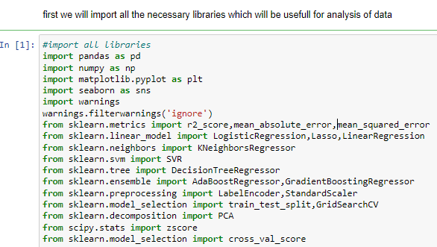
EDA steps step-1(import necessary libraries)

Slide 4
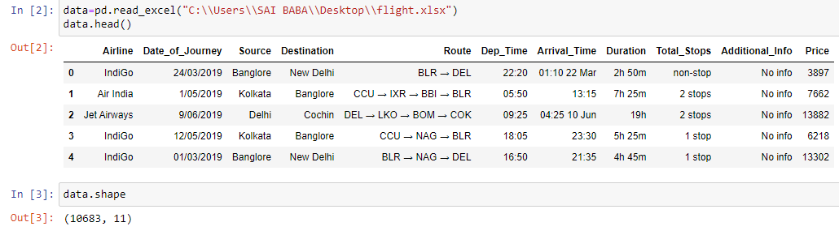
Step-2(extract the dataset in jupyter notebook) Data is extracted for further analysis in jupyter notebook

Slide 5
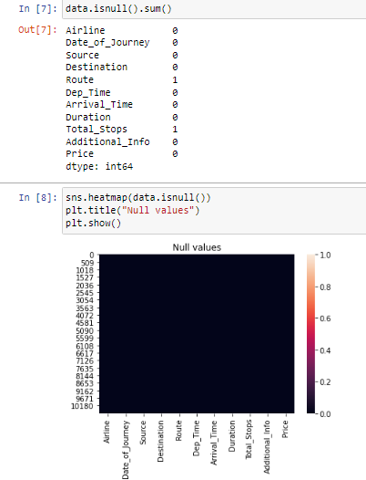
Step-3(checking null values)

Slide 6
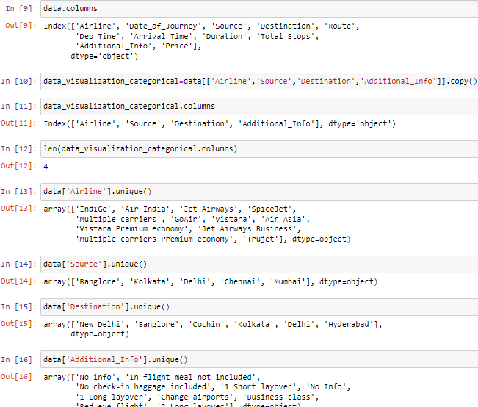
Making dataframe for categorical data

Slide 7
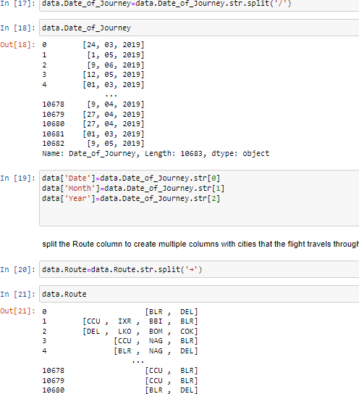
split the Date column

Slide 8
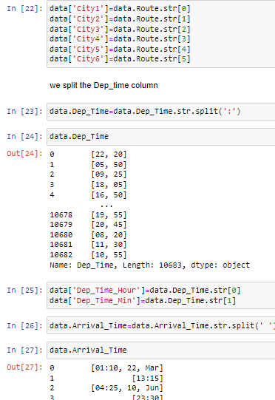
split the Route column

Slide 9
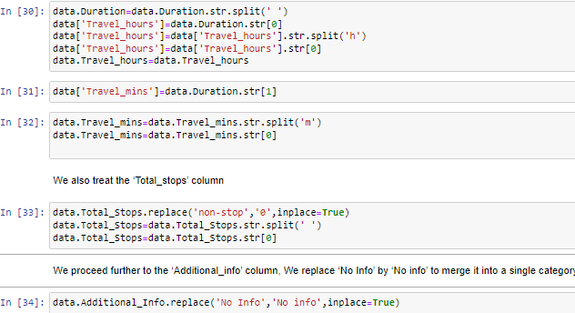
divide the ‘Duration’ column

Slide 10
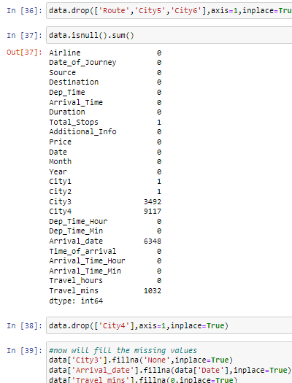
dropping the unwanted columns ,checking and removing the null values

Slide 11
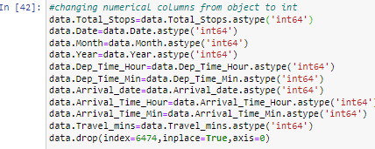
changing columns from object to integer

Slide 12
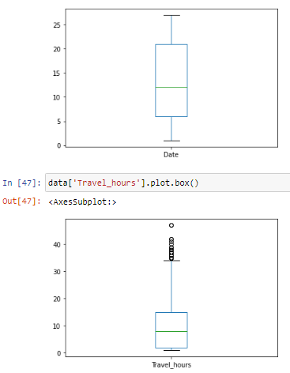
checking outliers

Slide 13
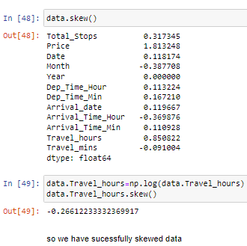
ckecking and removing the skewness

Slide 14
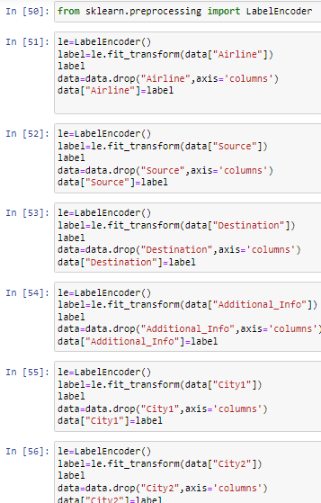
encoding the dataset data is encoded to convert object data to numerical

Slide 15
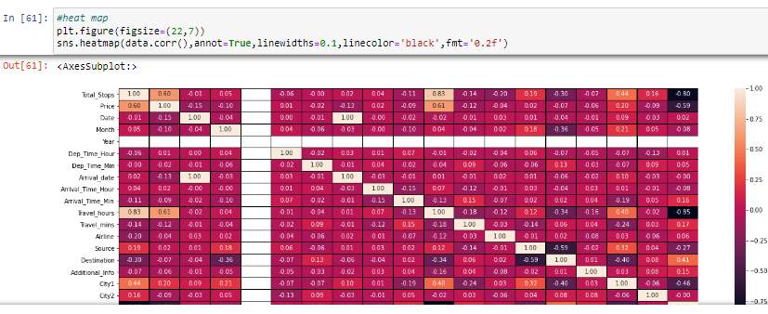
Heatmap it gives the correlation between target column and respective column it also gives positive and negative correlation of each column

Slide 16
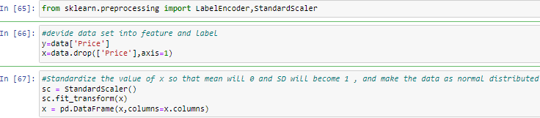
devide data set into feature and label data is devided into variable x and y for further analysis

Slide 17
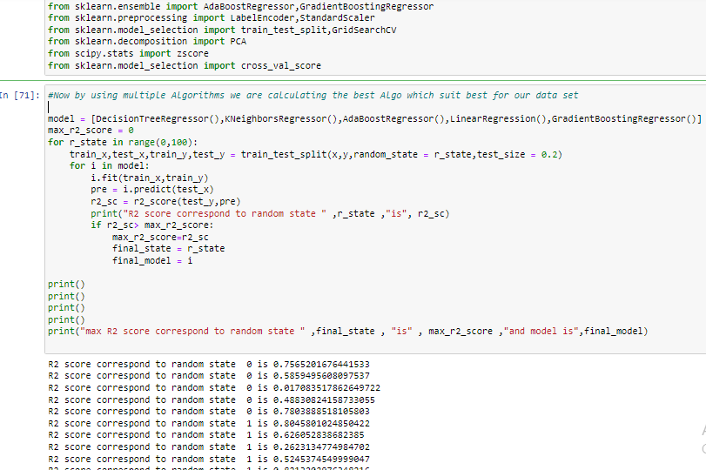
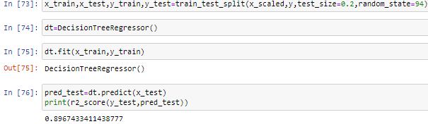
using multiple Algorithms we are calculating the best Algo

Slide 18
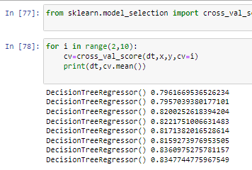
cross validation

Slide 19
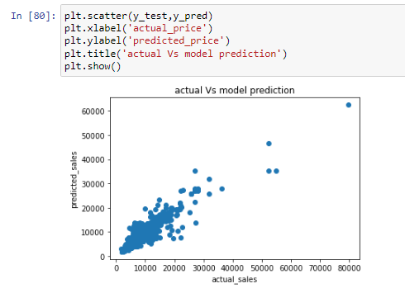
Scatter Plot it will gives the actual vs predicted price

Slide 20
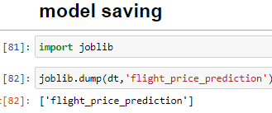
Model Saving we have saved the model successfully

Slide 21
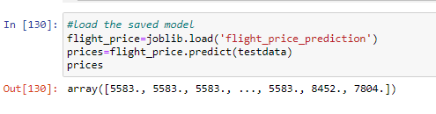
conclusion

Slide 22
We observed that data was filled with some outliers it is removed, also there some encoding is done now data is uniformly distributed in column. it is also observed from subplot, we have saved model and also predicted the result with help of saved model model is ready for the future data prediction.

